Slide 1

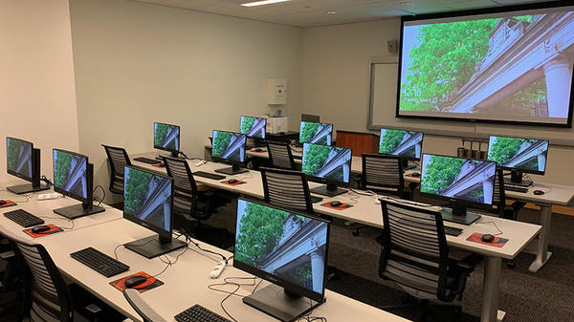
Suspicious Face Recognition
in computer-based academic lab monitoring
Ahmed M.H.A
190028C

Slide 2


The Problem
Majority of computer-based labs
Compact Seating arrangements
Higher manpower for monitoring
Real-Time Detection
Immediate Action

Slide 3
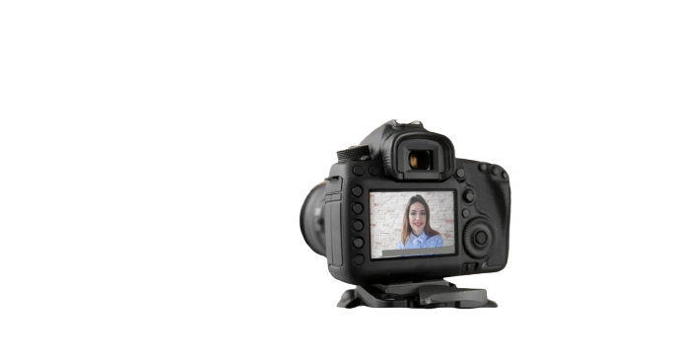


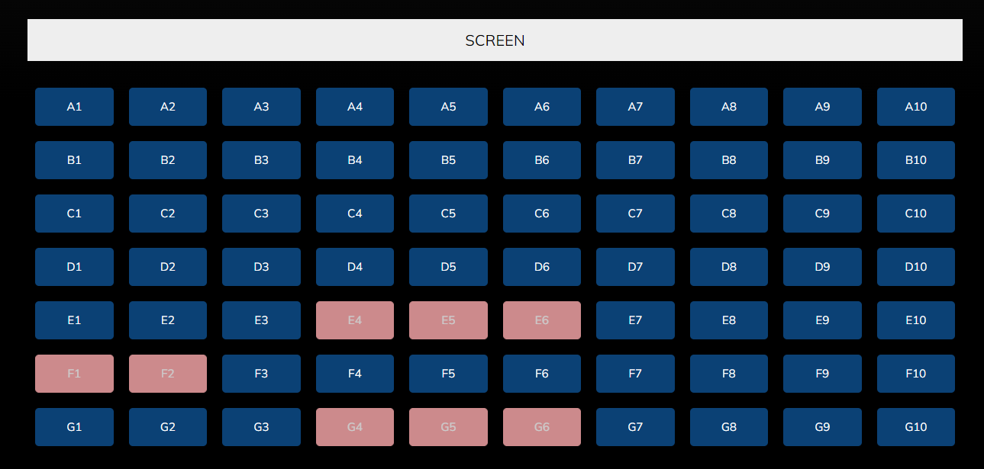

Sub Problems to be solved
Good quality video capturing
01
02
Accuracy of the Detection systems
Lighting
Pose
03
Real-time and push notifications
04
Multiple detections notified

Slide 4
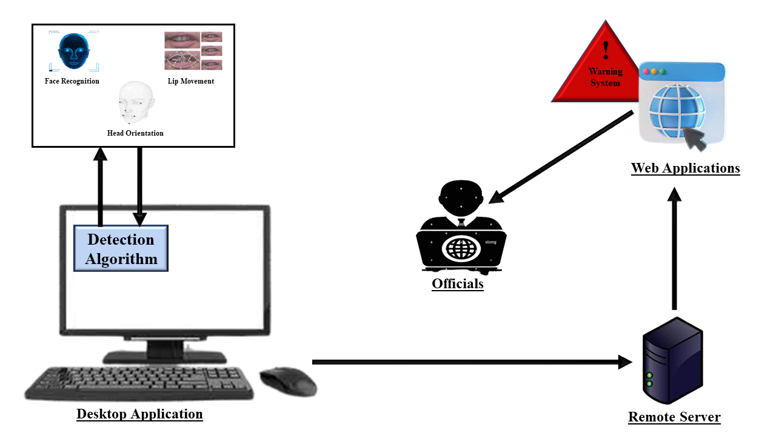
The Proposed System
Student Monitoring
Suspicious Activity Detection Algorithm
Face Detection
Head Orientation Detection
Lip Movement Detection
Remote Server
Graphical User Interface

Slide 5

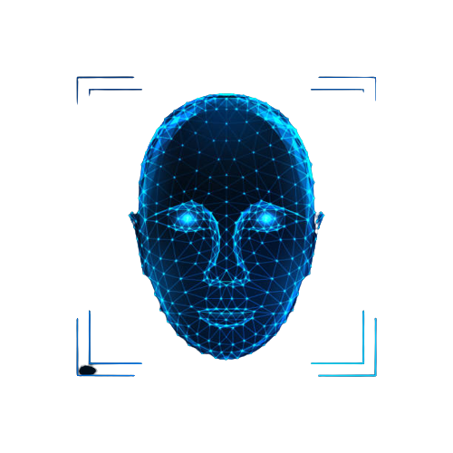

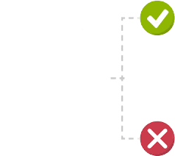

Face Detection
Suspicious Activity Detection Algorithm
‘No-Face’ Detection
‘Multi-Face' Detection
Tested Algorithms and Models
HOG feature classifier
MTCNN
MediaPipe Face Detection Model
Face
Not Face

Slide 6
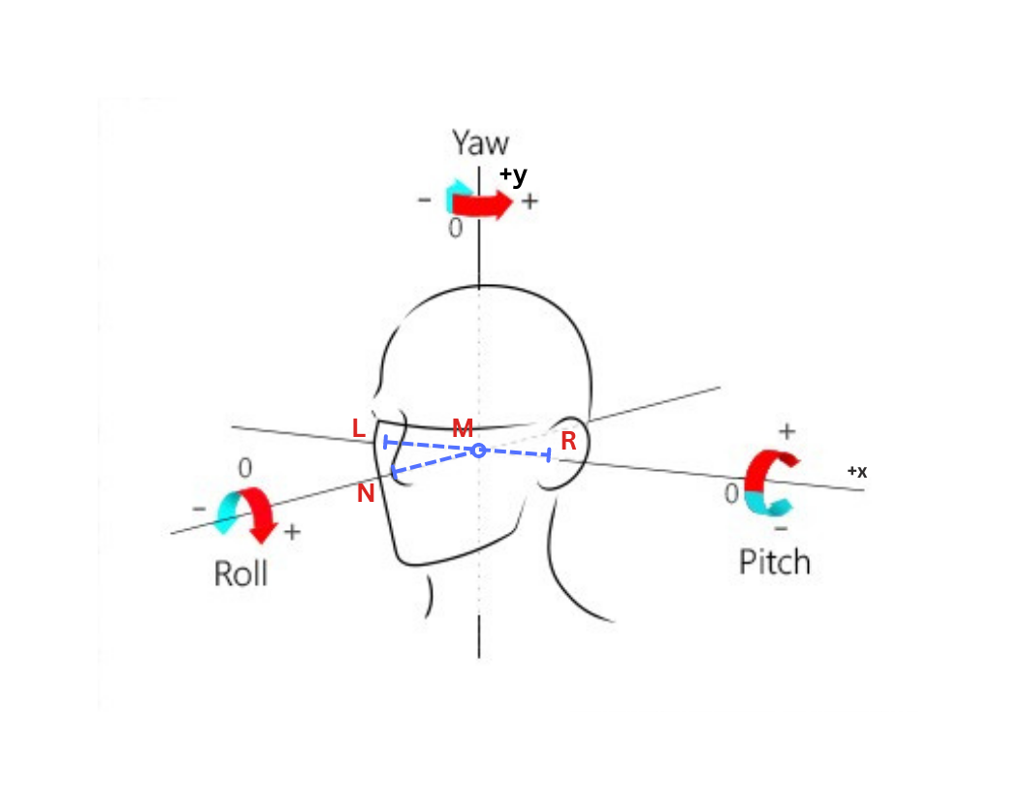
Head Orientation Detection
3D Coordinate Plane
MediaPipe Pose Estimation Model
Algorithm
Get Nose point coordinates (N)
Get Left and Right Ear point coordinates (L & R)
Get 3D line vector (LR)
Get 3D point (M)
Get 3D line vector (NM)
Get 3D Plane perpendicular to Camera (P)
Find angle between line NM & plane P

Slide 7
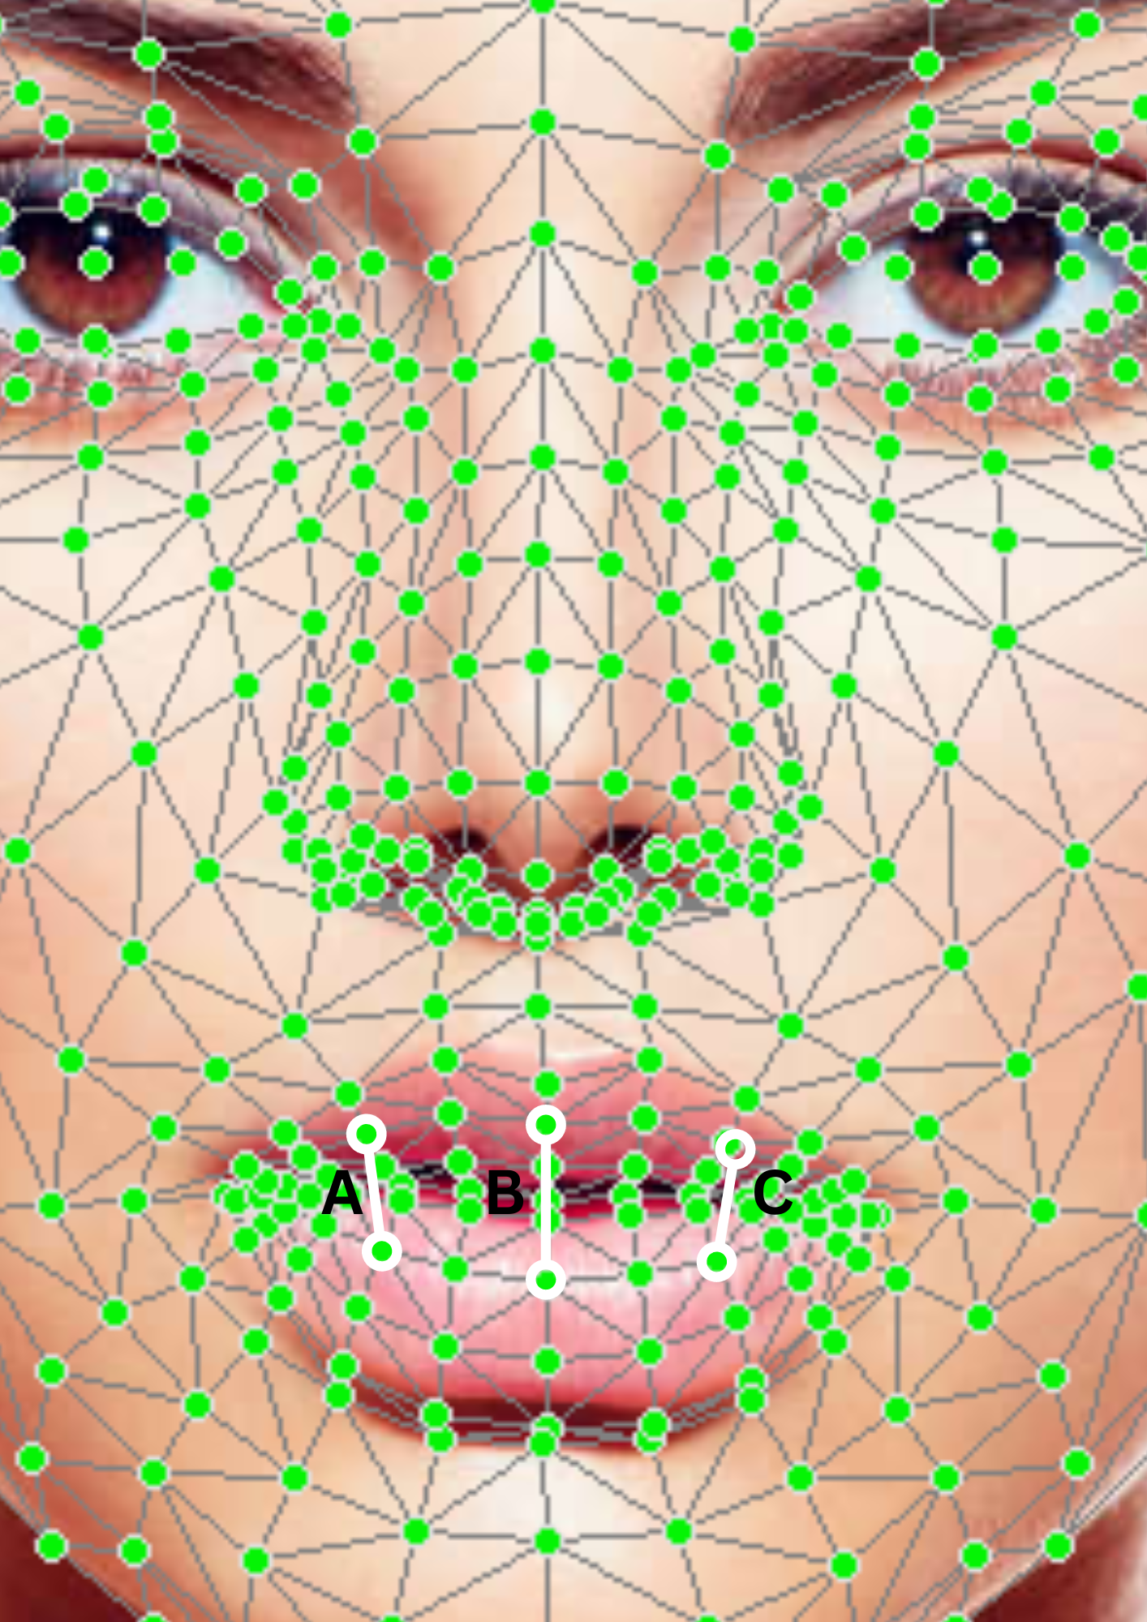
Lip Movement Detection
Collect sequence of frames
‘Speaking’ Detection
Recurrent Neural Network
‘Speaking’ Detection
Model pretrained using dlib face detector
Basis of Model
Consider 25 frames of the input webcam video
Fetch the points that mark the inner edges of the top and bottom lip.
Get the average pixel separation of A, B, C
Feed into the RNN model

Slide 8
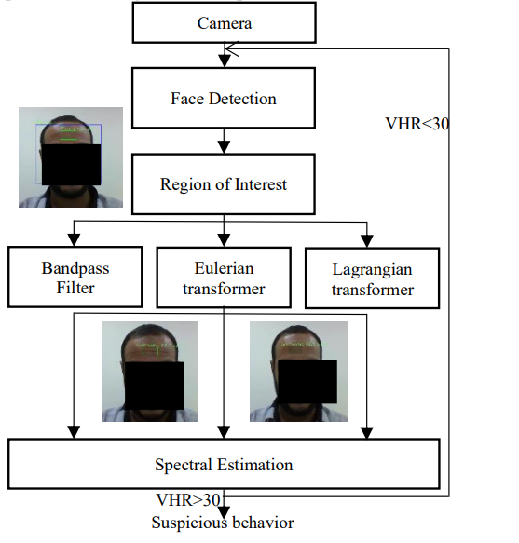
Research on Suspicious Behavior Recognition Based on Facial Features ¹
Fear - a suspect behavior
Heart rate estimation system
Bandpass Filter
Eulerian Transformer
Lagrangian Transformer
CK+ Dataset
¹ Mossaad, Ben Ayed & Elkosantini, Sabeur & Alshaya, Shaya & Abid, Mohamed. (2019). Suspicious Behavior Recognition Based on Face Features. IEEE Access. PP. 1-1. 10.1109/ACCESS.2019.2947338.

Slide 9
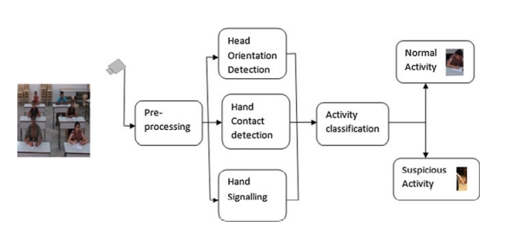
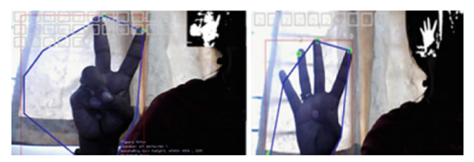
Research on Suspicious Human Activity Detection in Classroom Examination ²
Head Orientation Detection
Using HAAR features
Using AdaBoost classifier
Head pose variation beyond the threshold value
Hand Signaling Detection
Using Convex Hull of Hand Contour
Hand Movement Detection
Dilation and Erosion
² Senthilkumar, T., Narmatha, G. (2016). Suspicious Human Activity Detection in Classroom Examination. In: Senthilkumar, M., Ramasamy, V., Sheen, S., Veeramani, C., Bonato, A., Batten, L. (eds) Computational Intelligence, Cyber Security and Computational Models. Advances in Intelligent Systems and Computing, vol 412. Springer, Singapore. https://doi.org/10.1007/978-981-10-0251-9_11
Notes:
Haar can detect face only if the face orientation does not exceed above 30o in all other directions. The AdaBoost classifier is used to produce a better result in a less computation time.

Slide 10
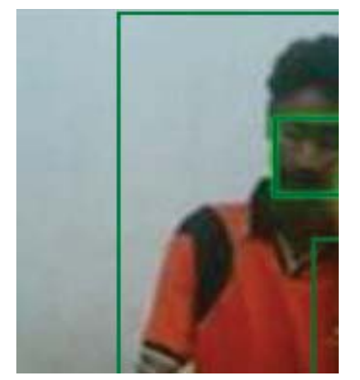
Research on Automated Invigilation System for Detection of Suspicious Activities during Examinations ³
Histogram of Oriented Gradients ( HOG ) Detection algorithm
Haar Feature Classifier
A part of Viola Jones algorithm
Fast in locating the mouth regions and face
Open Mouth Detection – With threshold limit
AdaBoost
Performance boosting algorithm
Sensitive to noise and outliers
³ M. Adil, R. Simon and S. K. Khatri, "Automated Invigilation System for Detection of Suspicious Activities during Examination," 2019 Amity International Conference on Artificial Intelligence (AICAI), 2019, pp. 361-366, doi: 10.1109/AICAI.2019.8701263.

Slide 11
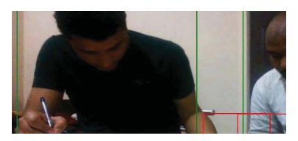
Research continued ….. Automated Invigilation System for Detection of Suspicious Activities during Examinations ³
Principal Component Analysis (PCA)
Eigen Face approach – simple & robust
Hand Contact Detection
Overlapping grid is detected outside own body grid
Head Orientation Detection
Using the Principal Component Analysis along with the Viola Jones algorithm
Based on the threshold
³ M. Adil, R. Simon and S. K. Khatri, "Automated Invigilation System for Detection of Suspicious Activities during Examination," 2019 Amity International Conference on Artificial Intelligence (AICAI), 2019, pp. 361-366, doi: 10.1109/AICAI.2019.8701263.

Slide 12
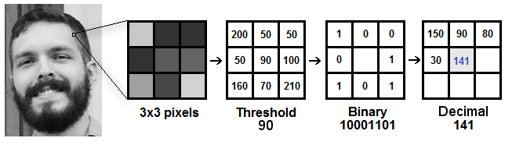
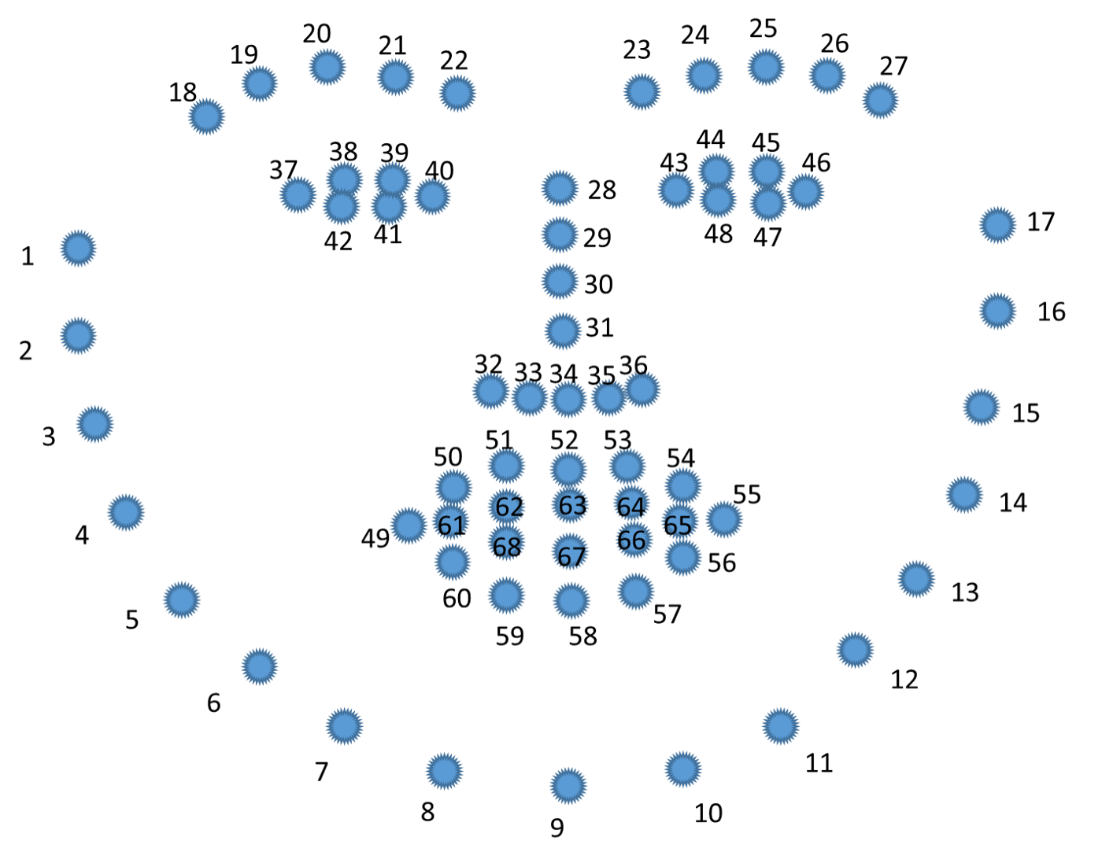
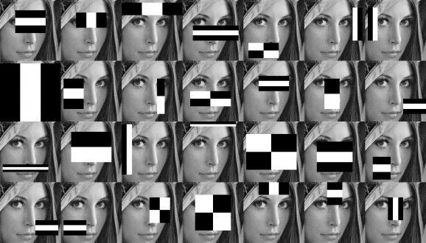
Research on Inference-Based Statistical Analysis for Suspicious Activity Detection Using Facial Analysis ⁴
Face Detection
Local Binary Pattern (LBP) Operator
Overcomes problems in PCA
Haar cascade algorithms
To prevent false results
Dlib
A face landmark detector with pre-trained models
⁴ M. Rastogi, R., Jain, R., Jain, P., Singhal, P., Garg, P., Rastogi, M. (2020). Inference-Based Statistical Analysis for Suspicious Activity Detection Using Facial Analysis. In: Das, A., Nayak, J., Naik, B., Dutta, S., Pelusi, D. (eds) Computational Intelligence in Pattern Recognition. Advances in Intelligent Systems and Computing, vol 1120. Springer, Singapore. https://doi.org/10.1007/978-981-15-2449-3_3

Slide 13
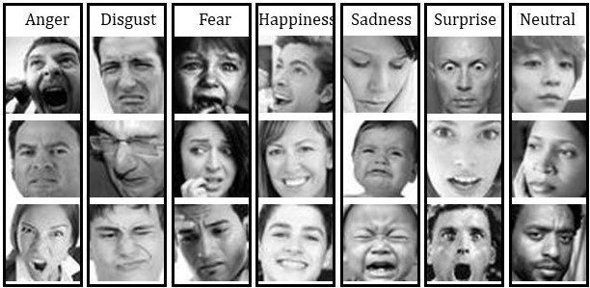
Research continued … Inference-Based Statistical Analysis for Suspicious Activity Detection Using Facial Analysis ⁴
Face Expression classification
Linear support vector machine SVM model
CK+ dataset
Face Alignment
SIFTROI - a preprocessing method
Face feature extraction
LBP, Supervised descent technique, WLD, WPLBP, HOG, ICA, PCA
⁴ M. Rastogi, R., Jain, R., Jain, P., Singhal, P., Garg, P., Rastogi, M. (2020). Inference-Based Statistical Analysis for Suspicious Activity Detection Using Facial Analysis. In: Das, A., Nayak, J., Naik, B., Dutta, S., Pelusi, D. (eds) Computational Intelligence in Pattern Recognition. Advances in Intelligent Systems and Computing, vol 1120. Springer, Singapore. https://doi.org/10.1007/978-981-15-2449-3_3

Slide 14
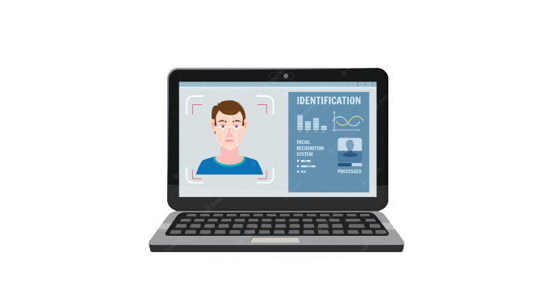

Demonstration of this project…
Suspicious Activity Detection Algorithm as a background application.
The Remote Server to which the information (time, pc info) related to the detected Suspicious Activity is sent in real-time.
The GUI of the App to show the detected suspects to the lab assistant or any other official.

Slide 15
Thank You!

